Slide 1
Computer vision and Web-app for Chinese White Dolphin
WONG Tsz Chun, Chris 55744759
CS4514 20CS001

Slide 2
Outline
Project background
Problems and Aims
Design solution
Training and Evaluation

Slide 3
Do you know the situation about the Chinese-White dolphin in Hong Kong?

Slide 4
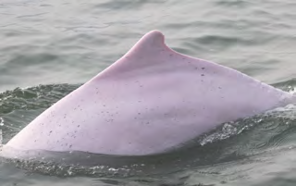
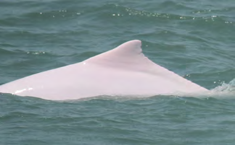
Background
Photo-identification technique
Identify the Chinese-white dolphins based on their unique fins
Gain the information such as the number and the distribution of them
Finally, know what challenges they are facing under various environmental or man-made factors
Identification number:
NL980536
Identification number:
NL1360135

Slide 5
Problems
Time-consuming
Costs a lot of money and labor resources
Human-mistakes
Affect the results

Slide 6
Aims of this project
Use deep learning technology to automatically and accurately recognize the marine mammals in images
Develop a web-application for the public to upload their marine mammals' images to gather information

Slide 7
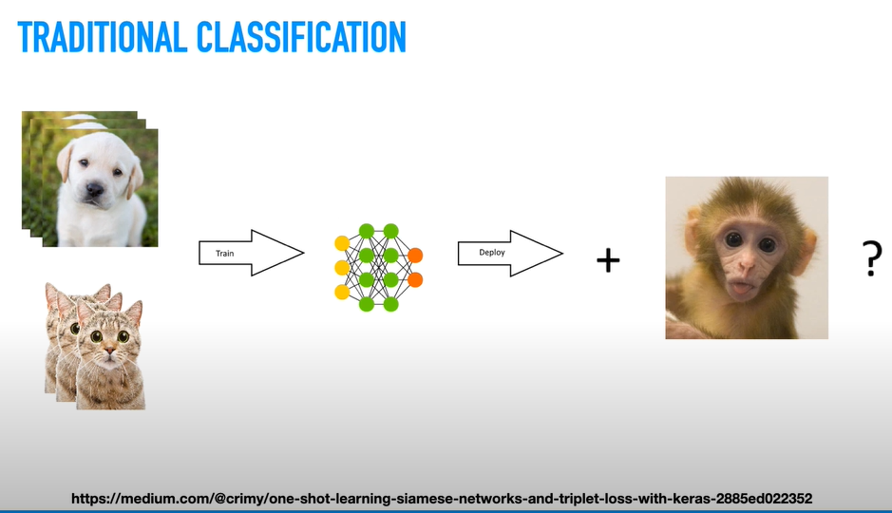
Design of solution
Drawbacks:
requires a lot of data samples as input
long training time
inefficient
Limitations:
Chinese-White dolphin is hard to capture
we only have a few data set for training

Slide 8
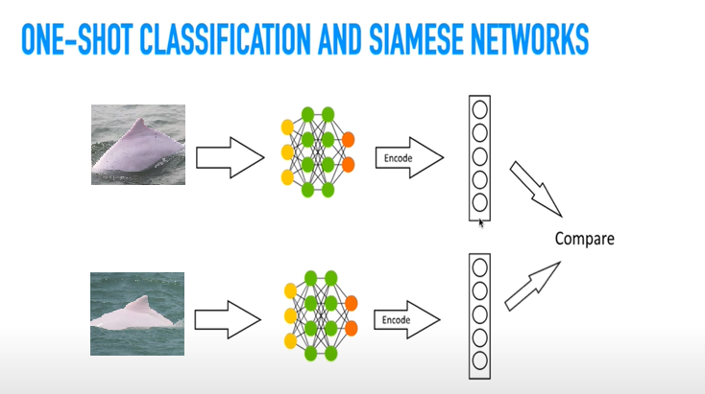
Design of solution
Siamese network architecture
the input images go through two networks
Two same networks
Same architecture, same weight(layer)
Use same loss function
Two different outputs
(used to decide they are similar or not)
One shot learning
Learning from one example
(limited data set)
Different from the above approach
(learning from multiple images)
https://medium.com/@crimy/one-shot-learning-siamese-networks-and-triplet-loss-with-keras-2885ed022352

Slide 9
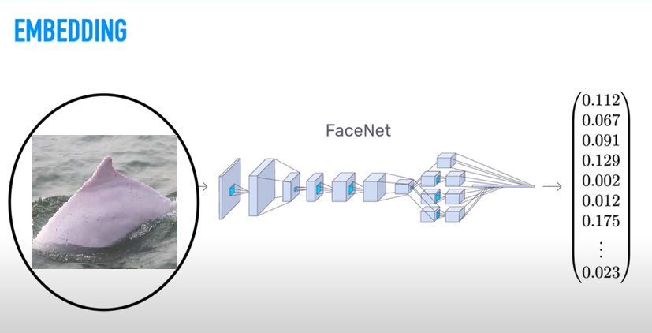
Design of solution

Slide 10
Design of solution
Embedding:
Used to analyze the similarity between two images
Train a specialized neural network to transform images into good embeddings (Triplet loss model)
It is a single vector
Two similar images have small mathematical distance
Two different images have large mathematical distance

Slide 11
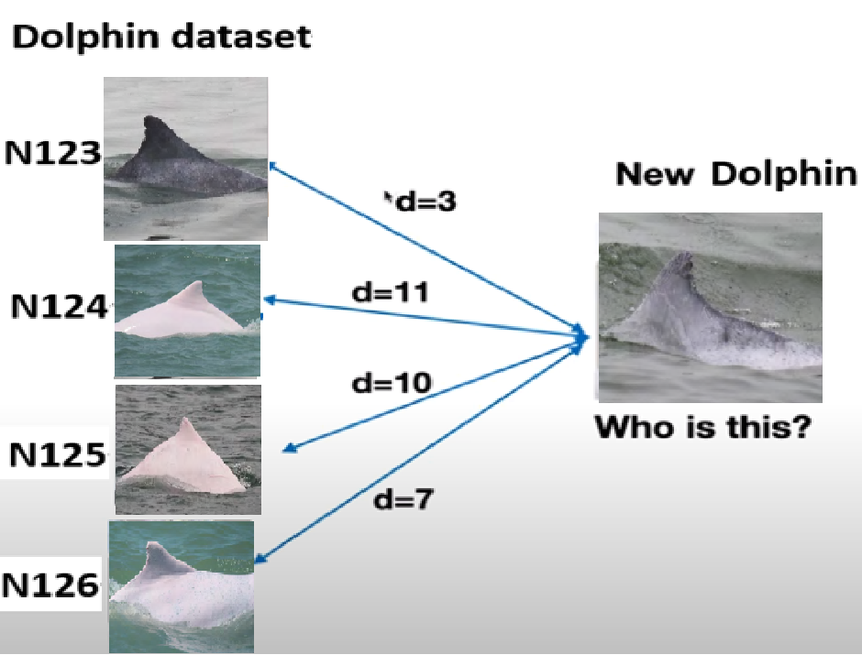
Design of solution
d(im1, im2) = Distance between two images
d(im1,im2) < r Same dolphin
d(im1,im2) > r Different dolphin
We will train the support vector machine to be the classifier

Slide 12
Training Process Of The Triplet Loss Model
14 classes and in total 164 dolphin images
We will divide it into a ratio of nearly 9:1 between the training and validation dataset.
The training dataset consists of 11 classes and 148 images.
The validation dataset consists of 3 classes and 16 images.
Trained around 12 hours

Slide 13
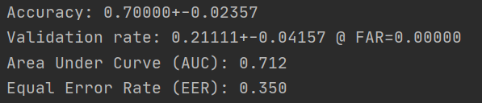
The Evaluation Result Of The Trained Triplet Loss Model
The accuracy is 70%
However, the validation is only about 21%.
The AUC, it is around 71%.

Slide 14
Training Process Of The Classifier
Divided the dataset into the training set and testing set into 90% to 10%
The training set contains 10 classes and 131 images.
The testing set contains 10 classes and 21 images.

Slide 15
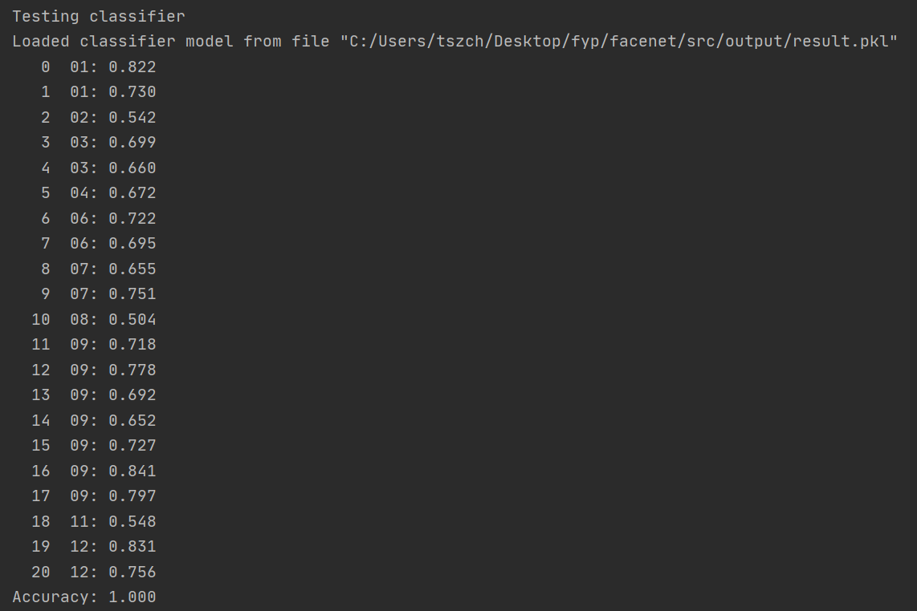
The Evaluation Result Of The Trained Classifier
The accuracy is 100%

Slide 16
Reference
https://medium.com/@dhartidhami/face-recognition-special-applications-of-cnn-51b928a3cd40
https://www.groundai.com/project/individual-common-dolphin-identification-via-metric-embedding-learning/1
https://towardsdatascience.com/one-shot-learning-face-recognition-using-siamese-neural-network-a13dcf739e
https://arxiv.org/abs/1503.03832

Slide 17
Q&A
Any questions?

